Slide 1
HR Employees Attrition
Narratives & Recommendations

Slide 2
Narratives
This analysis explores key drivers of employee satisfaction, performance, and attrition using HR data. By leveraging statistical measures and advanced visualization techniques, we provide actionable insights to improve employee retention, control attrition and organizational efficiency. The findings uncover patterns in performance and satisfaction and highlight risks and opportunities for strategic HR interventions.

Slide 3
Narratives: High Performance and Attrition Risk
High performing employees represent a critical segment of the workforce. Analysis reveals that employees with performance ratings significantly above the average performance rating threshold 3.69 (defined as 1.5 standard deviations beyond the mean) are concentrated in departments where employee's salary and recognition do not align with their contributions specifically in Sales Department. This disconnect poses a serious risk of attrition among the most talented employees, undermining organizational effectiveness

Slide 4
Narratives: Job and Environment Satisfaction
Employee satisfaction is a leading indicator of retention. Our findings show that employees with job or environment satisfaction scores below 3 (on a 5-point scale) are 3.6 times more likely to leave the organization. Departments with high workloads, overtime, or limited career growth opportunities are particularly impacted, indicating the need for targeted engagement strategies.

Slide 5
Narratives: Gender Diversity and Inclusion
An analysis of gender-based metrics highlights disparities in satisfaction and performance. Female employees in sales representative and laboratory technician roles report lower satisfaction levels despite demonstrating comparable performance to their male counterparts. This suggests potential gaps in equity and inclusivity, which could hinder retention and employee morale if not addressed.

Slide 6
Narratives: Departmental Insights
Departments such as Sales and Research & Development a significant proportion of high performers. However, these departments also show elevated attrition risks due to a combination of workload intensity, perceived lack of advancement opportunities and promotions, and Salary lower than the average. Addressing these gaps is essential to sustaining productivity and reducing turnover.

Slide 7
Narratives: Identifying Outliers
Outlier detection provides valuable insights into employee dynamics. Using statistical thresholds, we identified employees who stand out in terms of performance, salary, and satisfaction. These employees either represent retention risks or opportunities to leverage high performance. For example, employees with exceptionally high-performance ratings but lower-than-average salary need immediate attention to avoid attrition specially in sales representative, laboratory technician and research scientist job roles.

Slide 8
Narratives: Attrition Risk Prediction Score
The Attrition Risk Prediction Score integrates key metrics, including satisfaction, performance, and compensation (Monthly Income), to identify employees at risk of leaving. Employees with high prediction scores represent an actionable subset for HR interventions. This tool enables proactive retention strategies by prioritizing high-impact individuals.

Slide 9
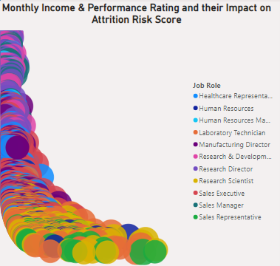
Narratives: Attrition Risk Prediction Score
Attrition Risk Prediction Score provide valuable Insights, we found that there is a correlation between Attrition Risk Score and Monthly Income (Salary) that as the Monthly Income Increase than the average the Attrition Risk Score decrease and vise versa

Slide 10
Narratives: Key Insights Summary
The analysis reveals that high performance, low satisfaction, and pay inequities are critical factors driving attrition. Gender disparities in satisfaction and challenges in workload balance highlight the need for a comprehensive approach to retention. Addressing these areas offers significant opportunities to enhance employee satisfaction and long-term organizational success.

Slide 11
Recommendations
Recommendations for Improving Employee Retention, Performance and Reduce Attrition. Based on the findings and analysis, the following recommendations are presented to address key areas of concern and opportunities for organizational improvement. Each recommendation is aligned with the insights derived from the data.

Slide 12
Recommendations: Retention of High Performers
Observation: High-performing employees face higher attrition risks, particularly in departments with lower compensation or recognition. Recommendations:
Enhance Incentives: Implement tailored salary adjustments and Stock Options for High Performing Employees specially with those who are in non career development roles such as sales representatives.
Career Development: Provide career development trainings
Employee Engagement: Provide career promotions for high performing employees ensure that there is a good work environment to avoid low environment satisfaction

Slide 13
Recommendations: Advancing Gender Diversity and Inclusion
Observation: Female employees in sales and Laboratory technician roles report lower Environment and Job satisfaction despite similar performance levels. Recommendations:
Audit Incentives: Implement tailored salary adjustments and Stock Options for them as the data shows that women take less salary than males for the same positions such as laboratory technician
Career Development: Provide career development trainings.

Slide 14
Recommendations: Increase Retention for Old Employees
Observation: there are some employees who have high performance and more than 10 years with us and leave us after all these long years Recommendations:
Audit Incentives: those people actually understand the company and systems infrastructures, we need to develop some incentives and opportunities inside the company for them.
Increase Employees Loyalty: develop promotions and high stock option ability to ensure their loyalty, also provide suitable working environment.

Slide 15
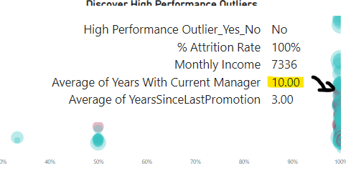
Recommendations: Utilizing Outlier Analysis for Attrition Risk Management
Observation: Outliers in performance and satisfaction metrics provide critical insights into potential retention risks. Recommendations:
Outlier Early Warnings: most people who attrite are working with the same manager for more than 6 years, that’s may indicate that they lose the ability to develop under his supervision so they leaved the company, or may they want to leave the comfort zone and find a new challenge, so we should improve ability and develop mechanism for those employees to reduce the Risk of Attrition

Slide 16
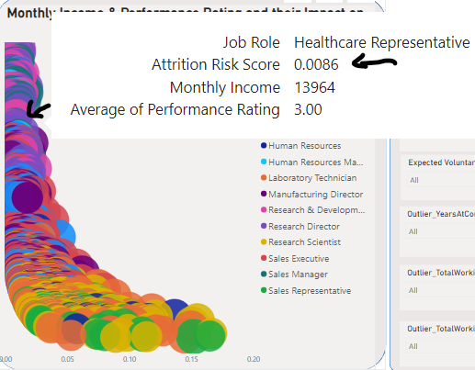
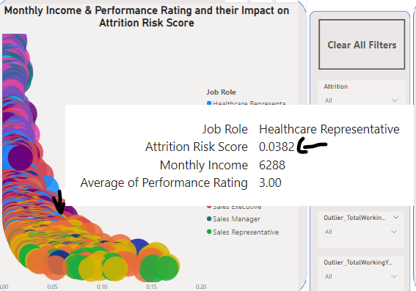
Recommendations: Utilizing Outlier Analysis for Attrition Risk Management
Observation: for the same position, you can find employees have the same performance rating and huge difference between their Monthly Income Salary so that leads to increase the Attrition Risk Score and create diversity between employees Recommendations:
Outlier Early Warnings: develop incentive compensations based on the performance rating for employees and rescale the Monthly salary to be based on job level, experience, and performance

Slide 17
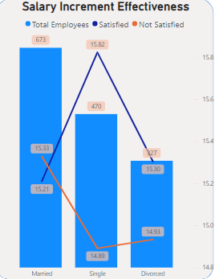
Recommendations: Salary Increment Effectiveness and Employees’ Marital Status
Observation: Employees who Married have High Not Satisfied Rate for the monthly income and salary hike, that is an Important route cause for attrition Recommendations: Develop some opportunities for development and salary incentives for them to make them concentrating at work and not have the desire to leave the company to due to low salary comparing with his/her family duties.

Slide 18
Recommendations: Gender-Based Retention Strategies
Observation: Job & Environment Satisfaction Strategies that support gender diversity as most of females (20%) leave the company because low job and environment satisfaction Recommendations: 1) Set measurable targets for improving gender balance across roles and departments.
2) Promote inclusivity through targeted leadership training and policy reviews.

Slide 19
Recommendations: Gender-Based Retention Strategies
Observation: There is a Low Job and Environment Satisfaction from Female Leaders and Managers in the Research & Development Department Recommendations: 1) Review the working culture in this department and most of females specially the top management have low Job and Environment satisfaction on it comparing with other departments

Slide 20
Best Regards

Slide 21


Microsoft Power BI

